Slide 1
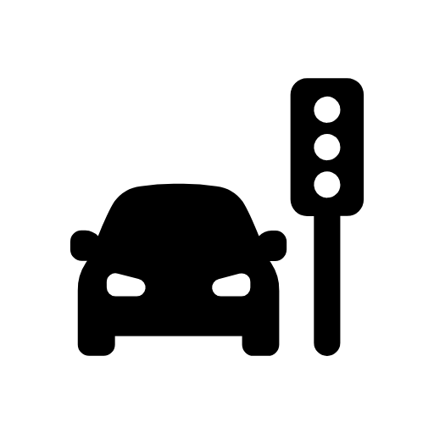



Can Responsive Traffic Lights Save Lives?
On average, an emergency vehicle used to lose 30 seconds trying to get through intersections.
With geo-fencing technology, an intersection can detect a fire truck and block oncoming traffic
Responsive traffic lights will now pre-emptively turn green for oncoming emergency vehicles.
Emergency vehicles now spend only 6 seconds getting through intersections. Thanks to responsive traffic lights, emergency vehicles can reach a crisis in San José faster, saving lives.

